Slide 1
Risk Management
Amir Akhlaghi

Slide 2
Definitions
Risk
Risk Management
Corrective Action
Correction
Preventive Action
Stockholders

Slide 3
Road map
Initiate
Quality Risk Management Process
Risk Assessment
Risk Identification
Risk Analysis
Risk Evaluation
unacceptable
R
n
i
o
s
i
k
t
a
M
c
Risk Control
a
i
n
n
a
u
g
m
Risk Reduction
e
m
m
o
e
C
n
k
t
s
Risk Acceptance
t
i
o
R
o
l
s
Output / Result of the
Quality Risk Management Process
Risk Review
Review Events

Slide 4
Risk
Identification

Slide 5
Risk Identification
Fishbone Diagram(Ishikawa)
Brain Storming

Slide 6
ISHIKAWA DIAGRAM

Slide 7
Ishikawa diagram
A graphic tool used when you need to identify and explore and display the possible causes of a specific problem or condition.
Developed to represent the relationship between some “effect and all the possible “causes” influencing it.
The effect or problem is stated on the right side of the chart and the major influences or ‘causes’ listed to the left
Causes might be summarized under the categories of Materials, Methods, Equipment, Environment, Leadership and People

Slide 8
Benefit of Ishikawa diagram
A cause and effect has these benefits:
It helps teams understand that there are many causes that contribute to an effect
It graphically displays the relationship of the causes to the effect and to each other
It helps to identify areas for improvement

Slide 9
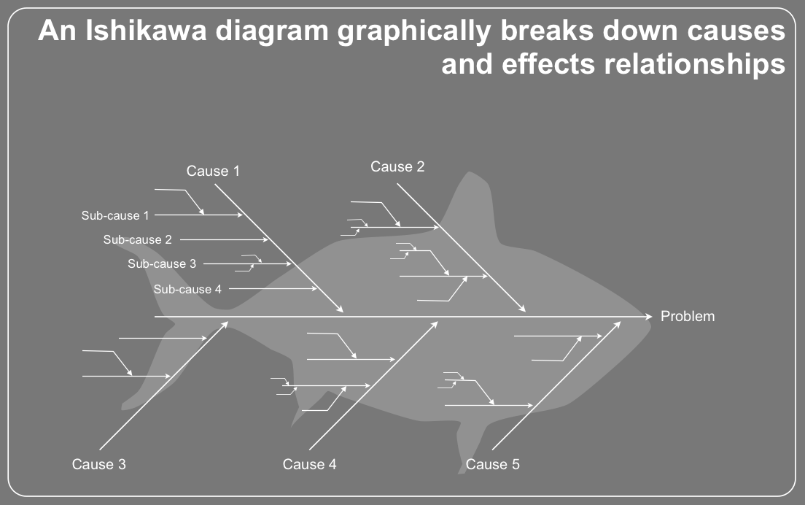
Ishikawa- Fishbone (Cause and effect) diagram

Slide 10
Ishikawa diagram
There are a few standard choices for different sectors (fishbone suggested categories):
Service Industries (4S)
· Surroundings · Suppliers
· System · Skills
(+ Safety)
Manufacturing Industries (6M)
· Machines · Methods
· Materials · Measurements
· Mother Nature (Environment)
· Manpower (People)
Administration/ Marketing (8P)
· Product (or service) · Price
· People · Place · Promotion
· Procedures · Processes
· Policies

Slide 11
Ishikawa diagram
Method – ways of doing things or the procedures followed to accomplish a task. A typical cause under the method category is not following instructions or the instructions are wrong.
Man – people are responsible for the problem. The problem may have been caused by people who are inexperienced.
Management – project management. Poor management decisions may cause technical problems.

Slide 12
Ishikawa diagram
Measurement – Problems may occur if measurements are wrong or the measurement technique used is not relevant.
Material – material basically refers to a physical thing. Software can't always handle errors caused by bad material, for instance a bad backup tape, so while material may be the least likely cause, it is a possible cause.
Machine – a machine in software usually refers to the hardware, and there are a lot of possibilities that a problem can be due to the machine.

Slide 13
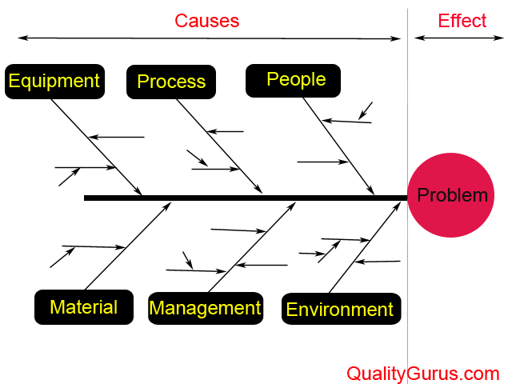
Sample of diagram

Slide 14
Brainstorming

Slide 15
Brainstorming
What is it?
A gathering of ideas from your brain onto paper.
The variety of ideas and the use of your imagination assist you in producing a lot of material with which to work.
Why do we need it?
It’s the best way to collect your thoughts.
It’s helpful for organization.
It ensures only quality ideas are used in the essay.

Slide 16
Brainstorming
Free Writing
Making a Cube
Clustering
Listing or Bulleting
Venn Diagram
Tree Diagram
Act like a Journalist
T-Diagram
Spoke diagram

Slide 17


Brainstorming Technique
Number One
Freewriting
Options:
Write for a specific time period
Write for a specific amount of paper

Slide 18
Brainstorming Technique
Number One
Freewriting
??????
When is it helpful?
When you have NO ideas about a topic
When you have TOO MANY ideas about a topic
Maybe I could say this or maybe I could say that… hmmm

Slide 19
Brainstorming Technique
Number Two
Making a Cube
What is it?
Imagine a cube. It has six sides. On each side, you have a different task regarding the topic.

Slide 20
Brainstorming Technique
Number Two
Making a Cube
Side One: Describe the topic.
Describe
Compare
Associate
Analyze
Apply
Argue
Side Two: Compare the topic.
Side Three: Associate the topic.
Side Four: Analyze the topic.
Side Five: Apply the topic.
Side Six: Argue for or against the topic.

Slide 21
Brainstorming Technique
Number Three
Clustering
What is it?
When you write down words or concepts associated with the topic – any ideas that come into your mind

Slide 22
Brainstorming Technique
Number Three
Global Warming
rainforests disappearing
extinction ^{emissions} dangerous
_{dying animals} toxic world wide
Cars/SUVs factories
landscape changes no icebergs
expensive to fix? hurricanes
Reversible?
Clustering
Draw a bubble.
And write the topic above it.
Brainstorm!
Now look for words that connect with each other. Circle the words and connect them with lines.

Slide 23
Brainstorming Technique
Number Four
Listing or Bulleting
What is it?
Create a list of terms/ideas/concepts about the topic. Create multiple lists depending on the purpose.
Global Warming
Toxic fumes
SUVs/Cars
Extinction
Belief/Disbelief
Kyoto Agreement
Belief/Disbelief
Scientists disagree
Average American
China/USA
Normal occurrence or abnormal event?

Slide 24
Brainstorming Technique
Number Five
Paris, France
Paris, Texas
Venn Diagram
Capital
Became Paris in 400 A.D.
francophone
Cities
Eiffel Tower
County seat
Anglophone
Founded in 1839
What is it?
Draw two circles that connect, like this:
List two topics above the circles.
Brainstorm about the topics – what do they have in common and what is unique about each one.

Slide 25


Brainstorming Technique
Number Five
Venn Diagram
When is it used?
When you are writing a comparison or contrast essay.
Paris, France
Paris, Texas
Capital
Became Paris in 400 A.D.
francophone
Cities
Eiffel Tower
County seat
anglophone
Founded in 1839

Slide 26
Brainstorming Technique
Number Six
Tree Diagram
What is it?
This diagram has a central idea to which you add branches that focus on details.

Slide 27
Brainstorming Technique
Number Six
Tree Diagram
When do you use it?
This type of diagram is helpful in classification essays.
Media
Print
Visual
Audio
Newspaper magazine booklet
television webpage movie
cd mp3 cassette

Slide 28
Brainstorming Technique
Number Seven
Act like a Journalist
What is it?
Using the question words in English to explore the topic.
Who?
Why?
Where?
When?
What?
How?

Slide 29
Brainstorming Technique
Number Seven
Act like a Journalist
When is it useful?
Use this technique when you want to write a narrative.
Why?
Who?
Where?
When?
What?
How?

Slide 30
Brainstorming Technique
Number Eight
T-Diagram
What is it?
Using a T shape, list a category that you want to compare or contrast about a specific topic or topics. Do this for a variety of categories.
Paris, France and Paris Texas
location
Europe
Northern France
North America
Northern Texas

Slide 31
Brainstorming Technique
Number Eight
T-Diagram
When is it useful?
This technique helps when you are writing a contrast or comparison essay.
Paris, France and Paris Texas
location
Europe
Northern France
North America
Northern Texas

Slide 32
Brainstorming Technique
Number Nine
Spoke Diagram
What is it?
Write the topic in a circle. Then think of about causes and effects. Write these around the circle like spokes on a wheel.
too many people
cars/suvs not recycling chopping down trees
Global Warming
Crazy weather
loss of polar ice caps
dying animals

Slide 33
Brainstorming Technique
Number Nine
Spoke Diagram
When is it useful?
Use this technique when you want to explore cause and effect.
too many people
cars/suvs not recycling chopping down trees
Global Warming
Crazy weather
loss of polar ice caps
dying animals

Slide 34
Risk Analysis

Slide 35
Risk Analysis
Failure Mode Effects Analysis [FMEA]
Fault Tree Analysis [FTA]
Hazard Operability Analysis [HAZOP]
Bow-tie
…

Slide 36
FTA
Fault Tree Analysis

Slide 37
Fault Tree Analysis
“A method to decompose it and look for situation that might lead to failure” (Software Engineering)
Displayed the logical path from effect to cause

Slide 38
Why Fault Tree Analysis (FTA) is carried out
To gain an understanding of the system
To document the failure relationships of the system
To exhaustively identify the causes of a failure
To assure compliance with requirements or a goal
To identify any weaknesses in a system
To prioritize contributors to failure
To identify effective upgrades to a system
To optimize operations and processing
To quantify the failure probability and contributors

Slide 39
Car Accident
Non-deer accidents
Deer in
Car fails to
Road
stop
Driver distracted
Brakes Fail
Brakes
applied

Slide 40
Top Event
Primary undesired event of interest
Denoted by a rectangle
Car Accident

Slide 41
Intermediate Event
Fault event that is further developed
Denoted by a rectangle
Brakes Fail

Slide 42
Basic Event
Event requiring no further development
Denoted by a circle
Deer in Roadway

Slide 43
Undeveloped Event
Low consequence event
Information not available
Denoted by a diamond
All non-Deer Causes

Slide 44
“OR” Gate
Output event occurs only if one or more input event occurs
Systems in series
+ , ∪ , union

Slide 45
“AND” Gate
Output event occurs only if all input events occur
Systems in parallel
• , ∩ , intersection

Slide 46
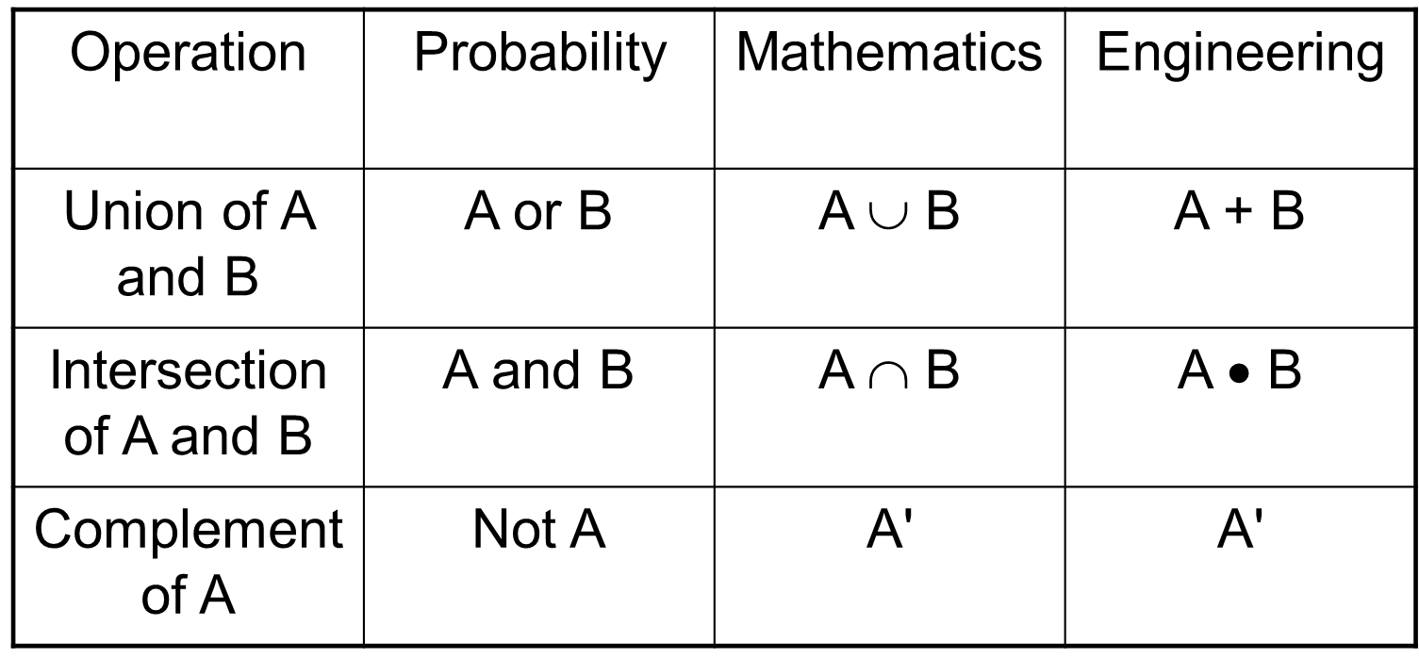
Boolean Algebra

Slide 47
Probability Possibilities
If S = F + G
P(S) = P(F) + P(G) – P(FG)
= P(F) + P(G) – P(F)P(G|F)
= P(F) + P(G) – P(F)P(G) if independent
= P(F) +P(G) if rare events
If S = F • G
P(S) = P(F)P(G) if independent

Slide 48
Deer Accident Equations
Car Accident (S) if
Deer in roadway (C) AND
Driver distracted (A) OR brakes fail (B)
S = (A ∪ B) ∩ C
S = (A + B) • C
S = (A union B) intersect C
S = (A intersect C) union (B intersect C)

Slide 49
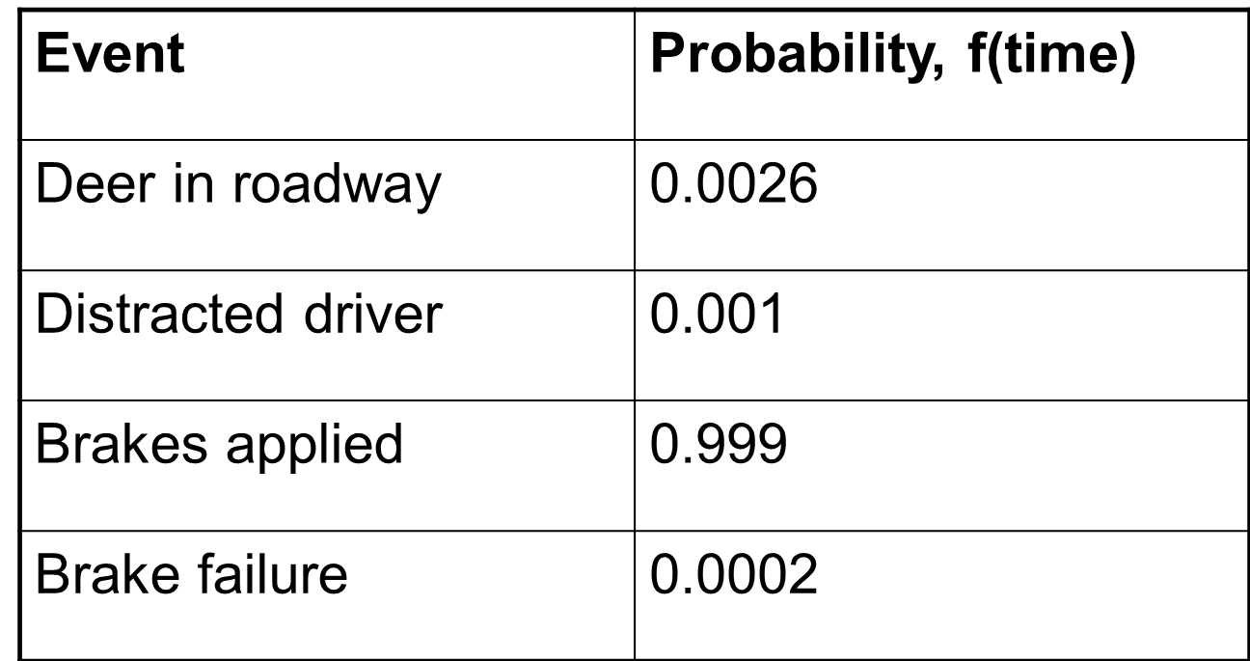
Probabilities

Slide 50
Deer Accident Probability
S = (A + B) • C
P(S) = [P(A) + P(B) – P(A)P(B|A)] ⋅ P(C)
Note: A and B are dependent (why?)
P(S) = [P(A) +P(B)] ⋅ P(C)
P(S) = (0.001 + 0.0002 × 0.999) × 0.0026
P(S) = 3 × 10⁻⁶

Slide 51
Example
High pressure
Reduce thickness
Die and Punch Function is proper
Proper
Proper tablet
Correctly changing of die and punch
Low
Product with low hardness
Mal function die and punch
partial
Product with low hardness
Improper tablets
complete
Improper tablet
Incorrectly changing of die and punch
Improper tablet

Slide 52
Deer in Road Event Tree Probabilities
Reduce thickness
(P = 0.25)
High pressure
(P = 0.99)
Proper tablet
Proper
Die and Punch Function is proper
(P = 0.60)
(P = 0.8)
Product with low hardness
low
(P = 0.15)
Correctly changing of die and punch
(P = 0.01)
partial
(P = 0.60)
Product with low hardness
Improper tablets
Mal function die and punch
(P = 1)
complete
(P = 0.40)
Improper tablet
(P = 0.2)
Incorrectly changing of die and punch
Improper tablet

Slide 53
Probabilities
Out come | Sub-outcome | calculation | Probability
Product tablet | (none) | 0.8*0.99*0.6 | 0.4752
Improper tablet | Correctly changing of die and punch | 0.8*(0.99*0.15+ 0.01*0.6) | 0.3216
 | Incorrectly changing of die and punch | 0.2+0.8*0.1*0.4 | 0.2032

Slide 54
FMEA
(Failure Mode and Effective Analysis)

Slide 55
FMEA
Why
Methodology that facilitates process improvement
Identifies and eliminates concerns early in the development of a process or design
Improve internal and external customer satisfaction
Focuses on prevention
FMEA may be a customer requirement (likely contractual)
FMEA may be required by an applicable Quality Management System Standard (possibly ISO)

Slide 56
FMEA
A structured approach to:
Identifying the ways in which a product or process can fail
Estimating risk associated with specific causes
Prioritizing the actions that should be taken to reduce risk
Evaluating design validation plan (design FMEA) or current control plan (process FMEA)

Slide 57
When to Conduct an FMEA
Early in the process improvement investigation
When new systems, products, and processes are being designed
When existing designs or processes are being changed
When carry-over designs are used in new applications
After system, product, or process functions are defined, but before specific hardware is selected or released to manufacturing

Slide 58
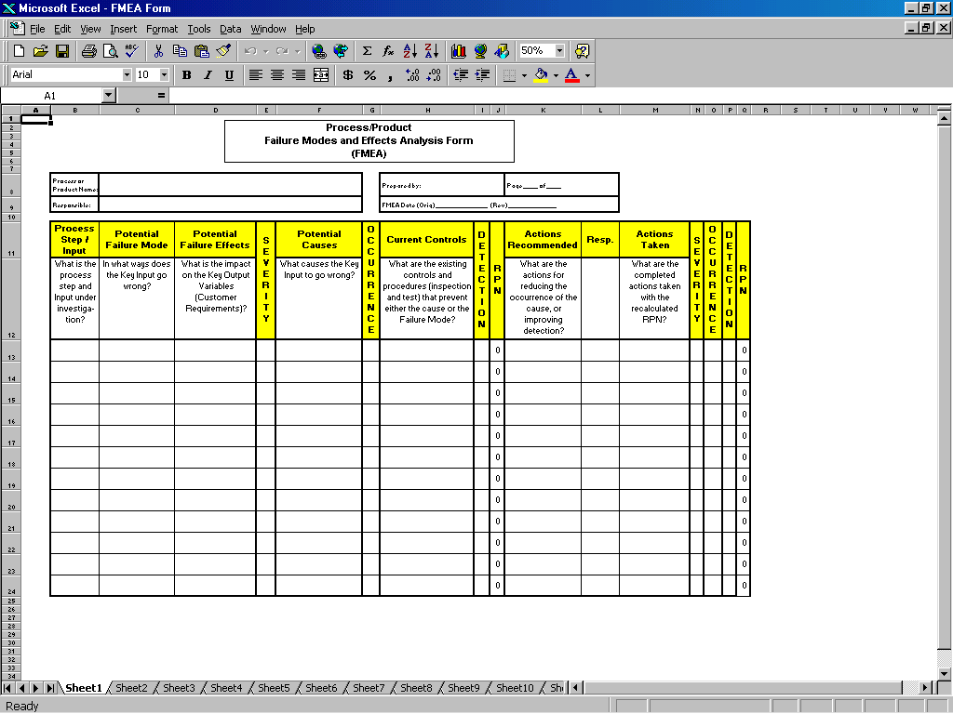
The FMEA Form
Identify failure modes and their effects
Identify causes of the failure modes
and controls
Prioritize
Determine and assess actions

Slide 59
Types of FMEAs
Design
Analyzes product design before release to production, with a focus on product function
Analyzes systems and subsystems in early concept and design stages
Process
Used to analyze manufacturing and assembly processes after they are implemented

Slide 60
FMEA: A Team Tool
A team approach is necessary.
Team should be led by the Process Owner who is the responsible manufacturing engineer or technical person, or other similar individual familiar with FMEA.
The following should be considered for team members:
– Design Engineers – Operators
– Process Engineers – Reliability
– Materials Suppliers – Suppliers
– Customers

Slide 61
FMEA Procedure
1. For each process input (start with high value inputs), determine the ways in which the input can go wrong (failure mode)
2. For each failure mode, determine effects
Select a severity level for each effect
3. Identify potential causes of each failure mode
Select an occurrence level for each cause
4. List current controls for each cause
Select a detection level for each cause

Slide 62
FMEA Procedure
5. Calculate the Risk Priority Number (RPN)
6. Develop recommended actions, assign responsible persons, and take actions
Give priority to high RPNs
MUST look at severities rated a 10
7. Assign the predicted severity, occurrence, and detection levels and compare RPNs

Slide 63
Severity, Occurrence, and Detection
Severity
Importance of the effect on customer requirements
Occurrence
Frequency with which a given cause occurs and creates failure modes (obtain from past data if possible)
Detection
The ability of the current control scheme to detect (then prevent) a given cause (may be difficult to estimate early in process operations).

Slide 64
Rating Scales
There are a wide variety of scoring “anchors”, both quantitative or qualitative
Two types of scales are 1-5 or 1-10
The 1-5 scale makes it easier for the teams to decide on scores
The 1-10 scale may allow for better precision in estimates and a wide variation in scores (most common)

Slide 65
Rating Scales
Severity
1 = Not Severe, 10 = Very Severe
Occurrence
1 = Not Likely, 10 = Very Likely
Detection
1 = Easy to Detect, 10 = Not easy to Detect

Slide 66
Risk Priority Number (RPN)
RPN is the product of the severity, occurrence, and detection scores.
Severity
X
Occurrence
X
Detection
=
RPN

Slide 67
HAZOP
(HAZard and OPerability study)

Slide 68
Definition
HAZARD:
Potential source of harm. Deviations from design or operational intent may constitute or produce a hazard. Hazards are the focus of HAZOP studies, and it should be noted that a single hazard could potentially lead to multiple forms of harm.
HARM:
Physical injury or damage to the health of people or damage to property or the environment. Harm is the consequence of a hazard occurring and may take many forms: patient or user safety, employee safety, business risks, regulatory risks, environmental risks, etc.

Slide 69
Usage
HAZOP is best suited for assessing hazards in facilities, equipment, and processes
and is capable of assessing systems from multiple perspectives:
Design
Physical and operational environments
Operational and procedural controls

Slide 70
Usage
Design
Assessing system design capability to meet user specifications and safety standards
Identifying weaknesses in systems

Slide 71
Usage
Physical and operational environments
Assessing environment to ensure system is appropriately situated, supported, serviced, contained, etc.

Slide 72
Usage
Operational and procedural controls
Assessing engineered controls (ex: automation), sequences of operations, procedural controls (ex: human interactions) etc.
Assessing different operational modes – start-up, standby, normal operation, steady & unsteady states, normal shutdown, emergency shutdown, etc.

Slide 73
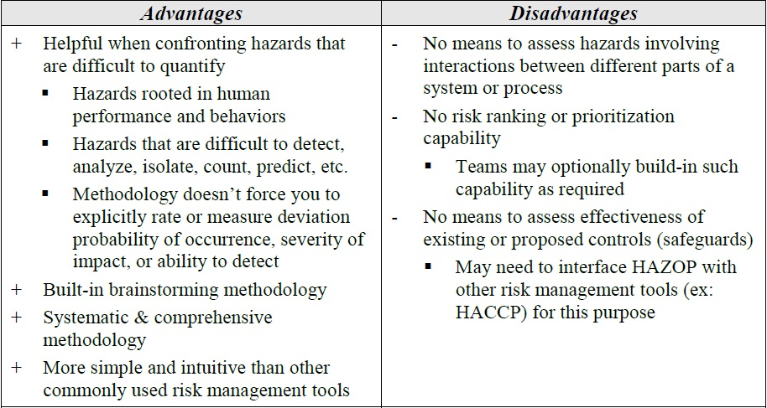
Usage

Slide 74
HAZOP Methodology
The HAZOP analysis process is executed in four phases as illustrated below:
Definition
Preparation
Examination
Documentation and follow up

Slide 75
Definition
Define scope and objectives
Define responsibilities
Select Team

Slide 76
Preparation
Plan the study
Collect data
Agree style of recording
Estimate the time
Arrange a schedule

Slide 77
Primary Key words
Primary keywords: a particular aspect of a design intent (a process condition or parameter).
Safety: Operability:
Flow Isolate
Temperature Start-up
Pressure Shutdown
Level Maintain
Corrode Inspect
Absorb Drain
Erode Purge
... ...

Slide 78
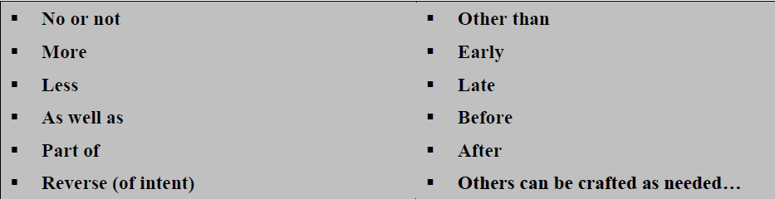
Secondary key words
Risk assessment teams are responsible for identifying the guide words that will best suit the scope and problem statement for their analysis. Some common HAZOP guide words include:

Slide 79
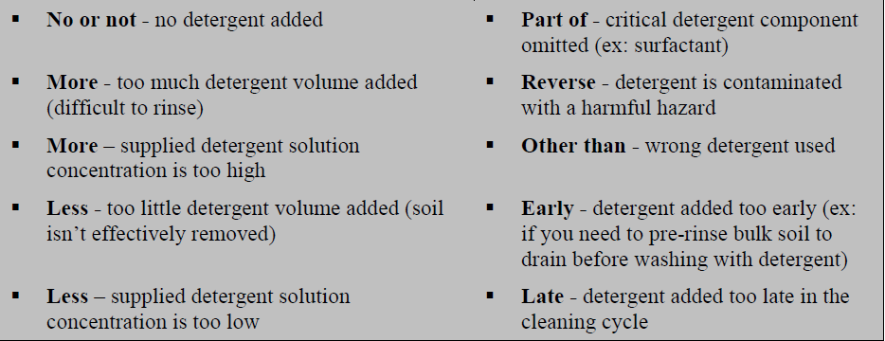
Guide words
HAZOP guide words work by providing a systematic and consistent means of brainstorming potential deviations to operations. The following example shows how different HAZOP guide words might be used to brainstorm deviations around detergent control for a cleaning operation:

Slide 80
Examination
Divide the system into parts
Select a part and define design intent
Identify deviation by using guide words on each element
Identify consequences and causes
Identify whether a significant problem exists
Identify protection, detection, and indicating
mechanisms
Identify possible remedial/mitigating measures
(optional)
Agree actions
Repeat for each element and then each part

Slide 81
Documentation and follow up
Record the examination
Sign off the documentation
Produce the report of the study
Follow up that actions are implemented
Re-study any parts of system if necessary
Produce final output report

Slide 82
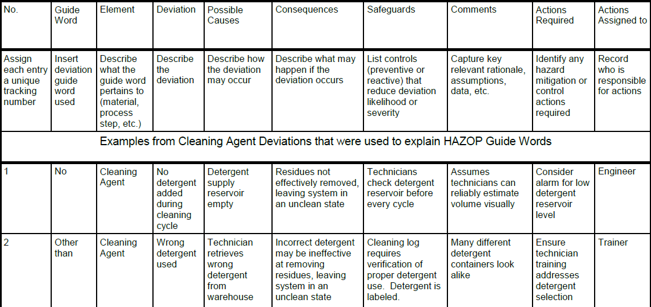
HAZOP Format report

Slide 83
BOW-TIE

Slide 84
Why Bow-tie
Visualization of the relationship between undesirable event, its causes, accidental scenarios, the preventive and mitigation measures to limit their consequences
Demonstrates the effectiveness of existing controls
Structured risk analysis where quantification is not possible or desired
Extremely versatile / Success in various applications
Required multidisciplinary team

Slide 85
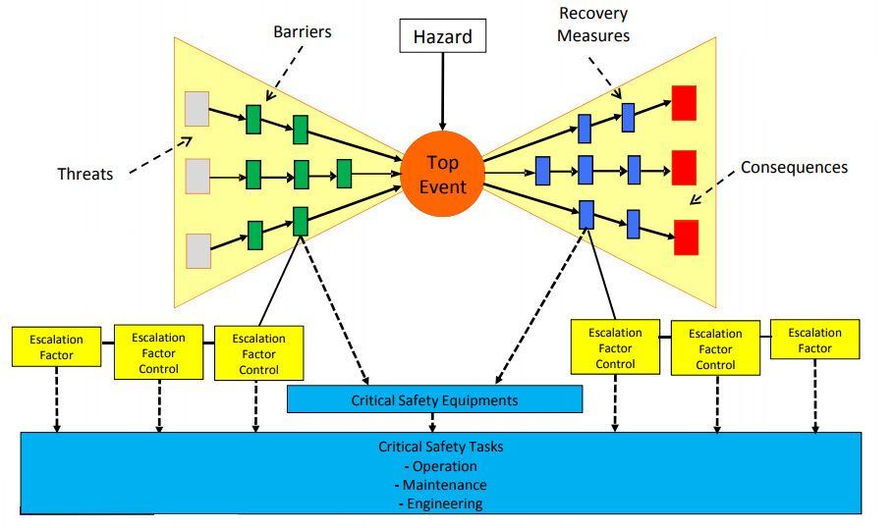
Bow-tie diagram

Slide 86
Bow-tie diagram construction
Define the Hazard and the Top Event which is the initial consequence "What happens when the danger is" released "?"
Identify the Threats which are the Top Event causes "What causes the release of danger? "How can lost control?
Identify the existing Protection Barriers each Threat
Prevent the Top Event occurrence
Can be independents or dependents
"How can controls fail?"
"How can that their effectiveness can be compromised?"

Slide 87
Bow-tie diagram construction
4. Identify for each Barrier their Escalation Factors - Factors that make the Barrier fail
“How can we avoid that the hazard being released? “How can we keep the control?”
5. Identify for each Barrier their Escalation Factors Control
Factors that prevent or minimize the possibility of the Barrier or the
Recovery Measures becomes ineffective
"How to ensure that the controls will not fail?"
6. Identify the consequences
- Top Event could have several consequences

Slide 88
Bow-tie diagram construction
7. Identify the Recovery Measures
Factors that make the barriers fail
"How can we limit the severity of the event?”
"How can we minimize the effects?"
8. Identify for each Recovery Measure their Escalation Factors and Escalation Factors Controls 9. For each Barrier, Recovery Measures and Escalation Factors Controls identify the Critical Safety Tasks

Slide 89
Critical Safety Tasks
Tasks prevent and/or minimize the possibility of the Barrier, the Escalation Factor Control or the Recovery Measures fails or becomes ineffective
What tasks can be taken to ensure that the control is working?
Project engineering, operation, maintenance, management.
"How can we ensure that these tasks are done?"
"Who do these tasks?
"How do you know when to do the tasks?"?
"How do you know what to do?“
"Is there a procedure, checklist, instruction?"

Slide 90
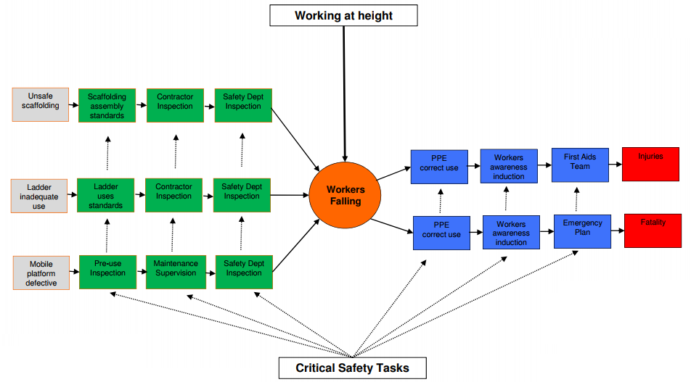
Example

Slide 91
RISK CONTROL

Slide 92
Risk control
Risk control describes the actions of implementing risk management decisions.
What can be done to mitigate and reduce risks?
What options for controlling risks are available?
What are the impacts of current risk management decisions on future options for risk management?
Risk mitigation focuses on a reduction of severity of harm.
Risk reduction focuses on the reduction of probabilities of occurrence of harm and detection of harm.
Risk acceptance is a decision to accept risk, i.e., no additional risk control activities are necessary at that time.

Slide 93
Swiss cheese model

Slide 94
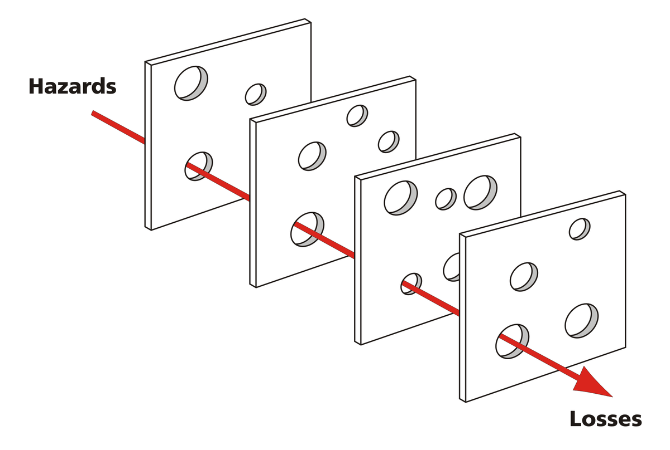
Swiss cheese model

Slide 95
“We cannot change the human condition
But…
we can change the conditions under which humans work”
James Reason

Slide 96
Swiss cheese
Defences are only as strong as their weakest link!
Some holes due
to active failures
Hazards
Other holes due to
latent conditions
Losses
A System Model of Accident Causation

Slide 97
Swiss cheese model
How do you close the hole’s in the Swiss Cheese
Design strong defenses
Engineer problem away
Include human factors design (later)
Build in reliable processes

Slide 98
Pareto Chart

Slide 99
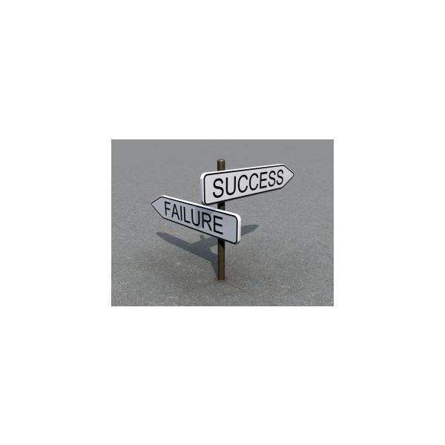
Pareto analysis
Pareto analysis is a formal technique useful where many possible courses of action are competing for attention.
Pareto analysis is a creative way of looking at causes of problems because it helps stimulate thinking and organize thoughts.

Slide 100
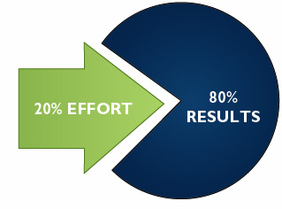
Pareto Chart
This technique helps to identify the top 20% of causes that needs to be addressed to resolve the 80% of the problems.

Slide 101
Pareto
80% of sales are generated by 20% of customers.
80% of Quality costs are caused by 20% of the problems.
80% of problem in production line are generated by 20% of causes.

Slide 102
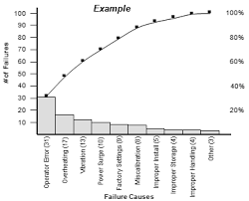
HOW TO USE IT ?

Slide 103
How to use it?
1. Gather facts about the problem, using Check Sheets or Brainstorming, depending on the availability of information.
2. Rank the contributions to the problem in order of frequency.
3. Draw the value (errors, facts, etc) as a bar chart.
4. It can also be helpful to add a line showing the cumulative percentage of errors as each category is added. This helps to identify the categories contributing to 80% of the problem.
5. Review the chart – if an 80/20 combination is not obvious, you may need to redefine your classifications and go back to Stage 1 or 2.

Slide 104
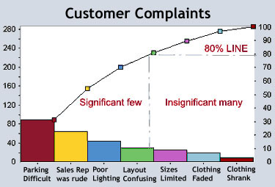
Pareto chart

Slide 105
Risk communication

Slide 106
Risk communication
Risk communication is the exchange or sharing of information about risk and risk management between the decision maker and other stakeholders. The information can relate to the existence, nature, form, probability, severity, acceptability, treatment, detectability or other aspects of risks to quality.
The communication among stakeholders concerning quality risk management decisions can be made through existing channels.

Slide 107
Risk monitoring and review

Slide 108
Risk Monitoring and review
All risk management processes are dynamic/iterative. Quality risk management when applied should benefit from new knowledge with each decision cycle and used to enhance future decisions allowing for continuous improvement.

Slide 109
Thanks for attention

